Slide 1
Cross Validation

Slide 2
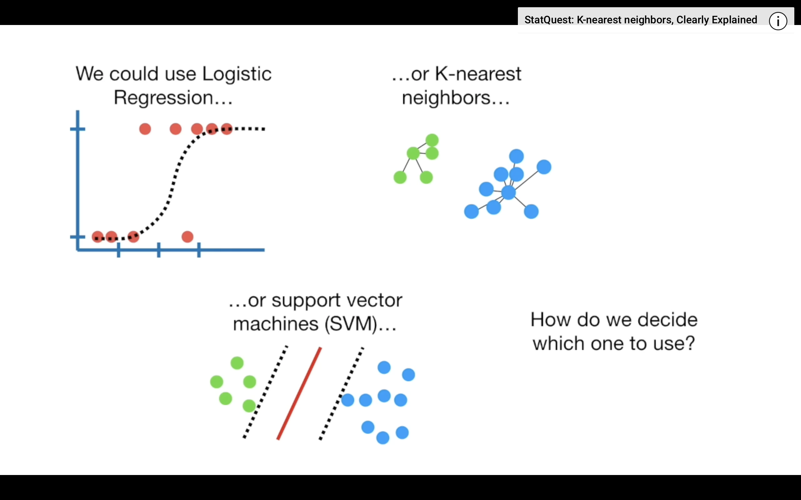
Comparing Data Mining Algorithms

Slide 3

We need it to do two(2) things with this data
Estimate the parameters for the Data Mining algorithm
Evaluate how well the Data Mining method works (testing )

Slide 4
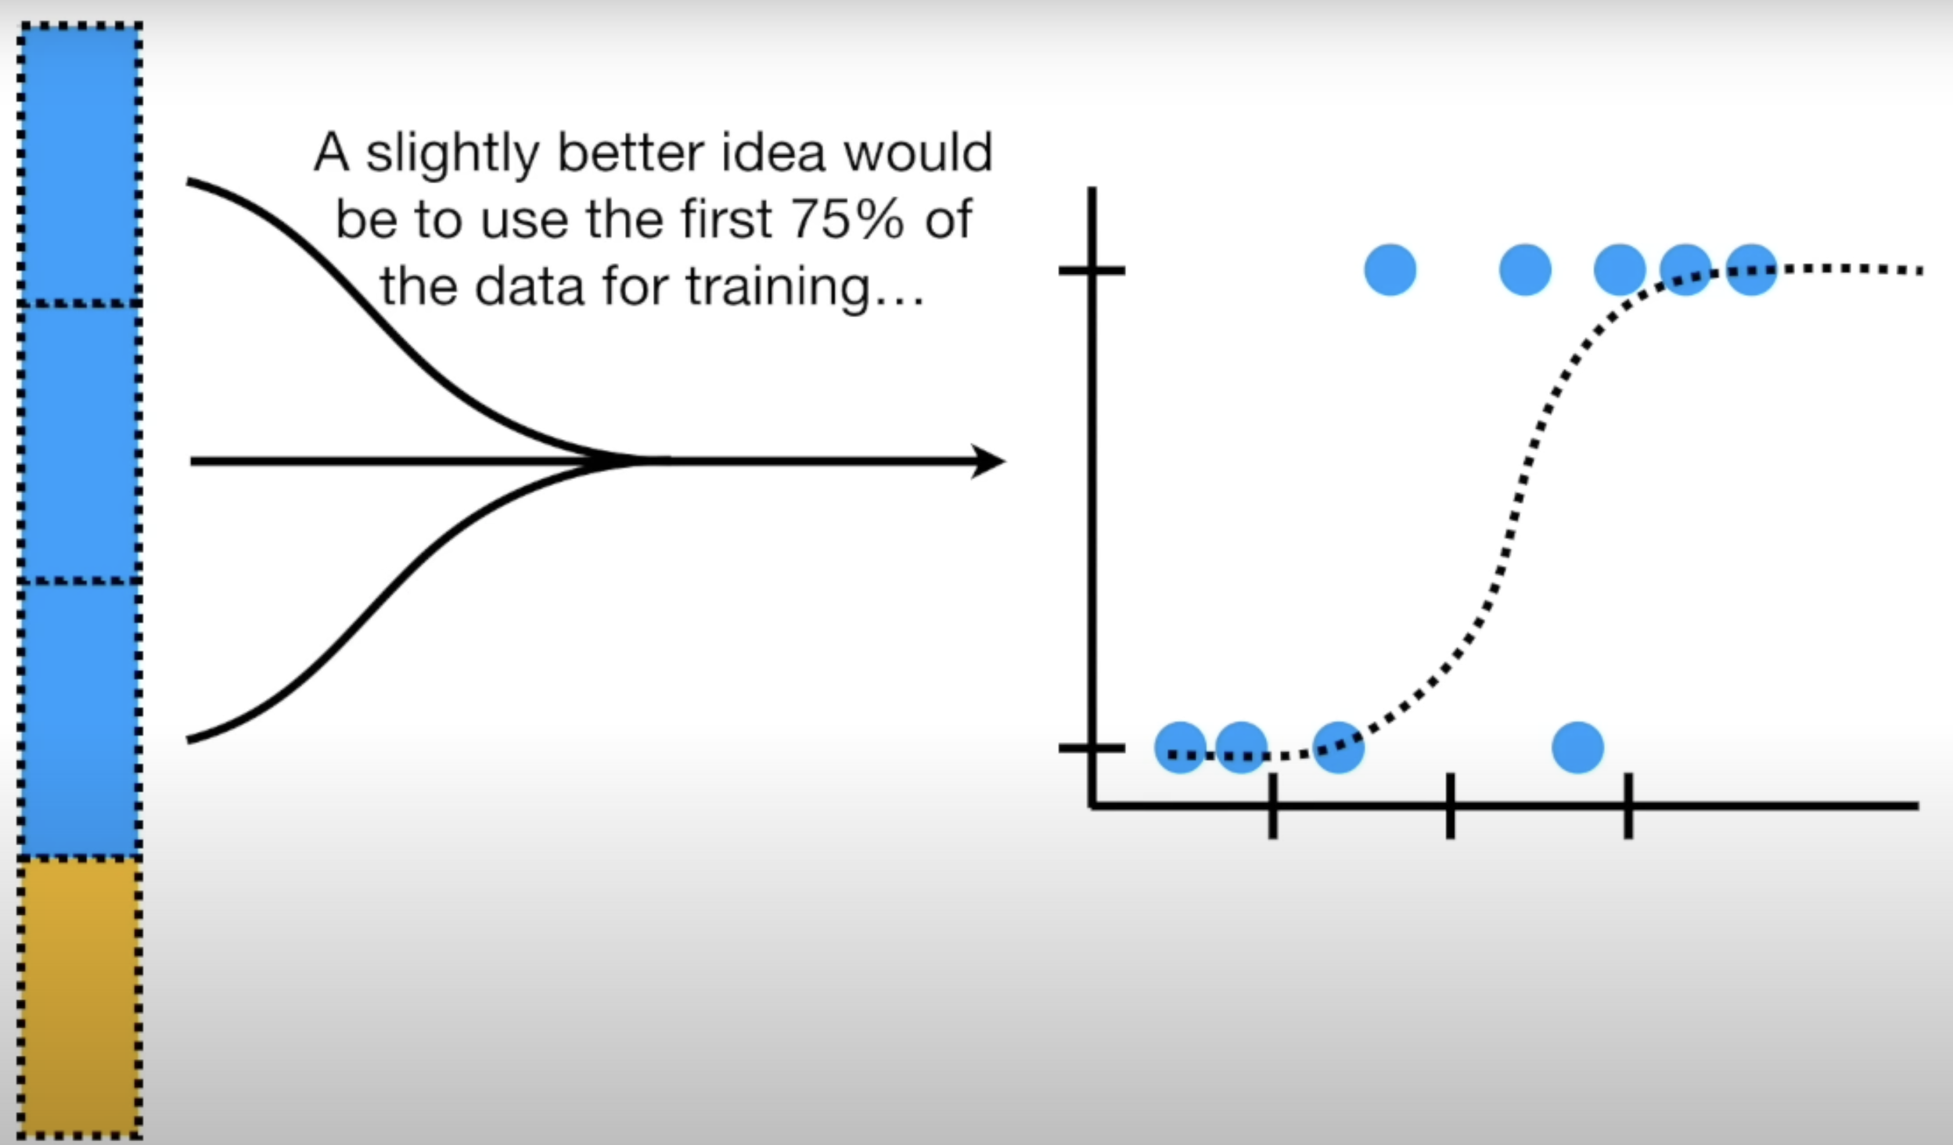

Slide 5
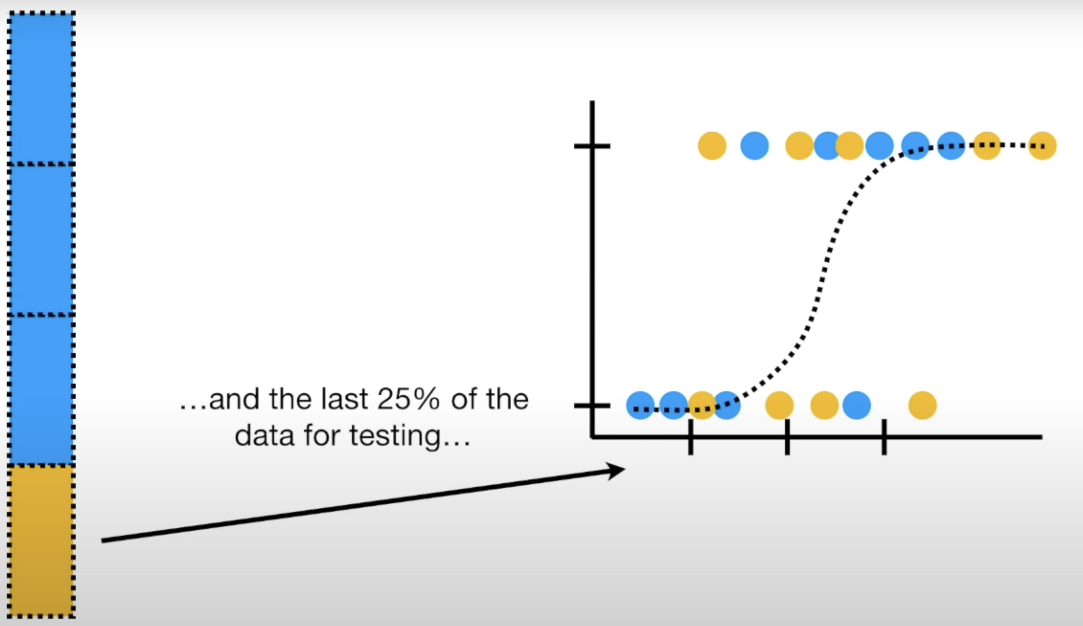

Slide 6
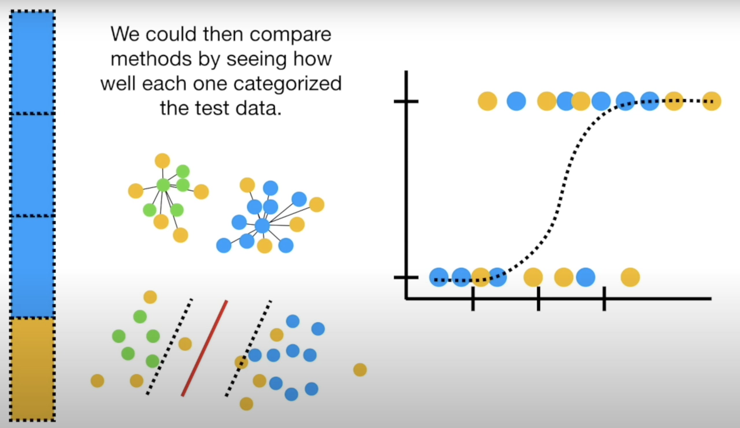

Slide 7
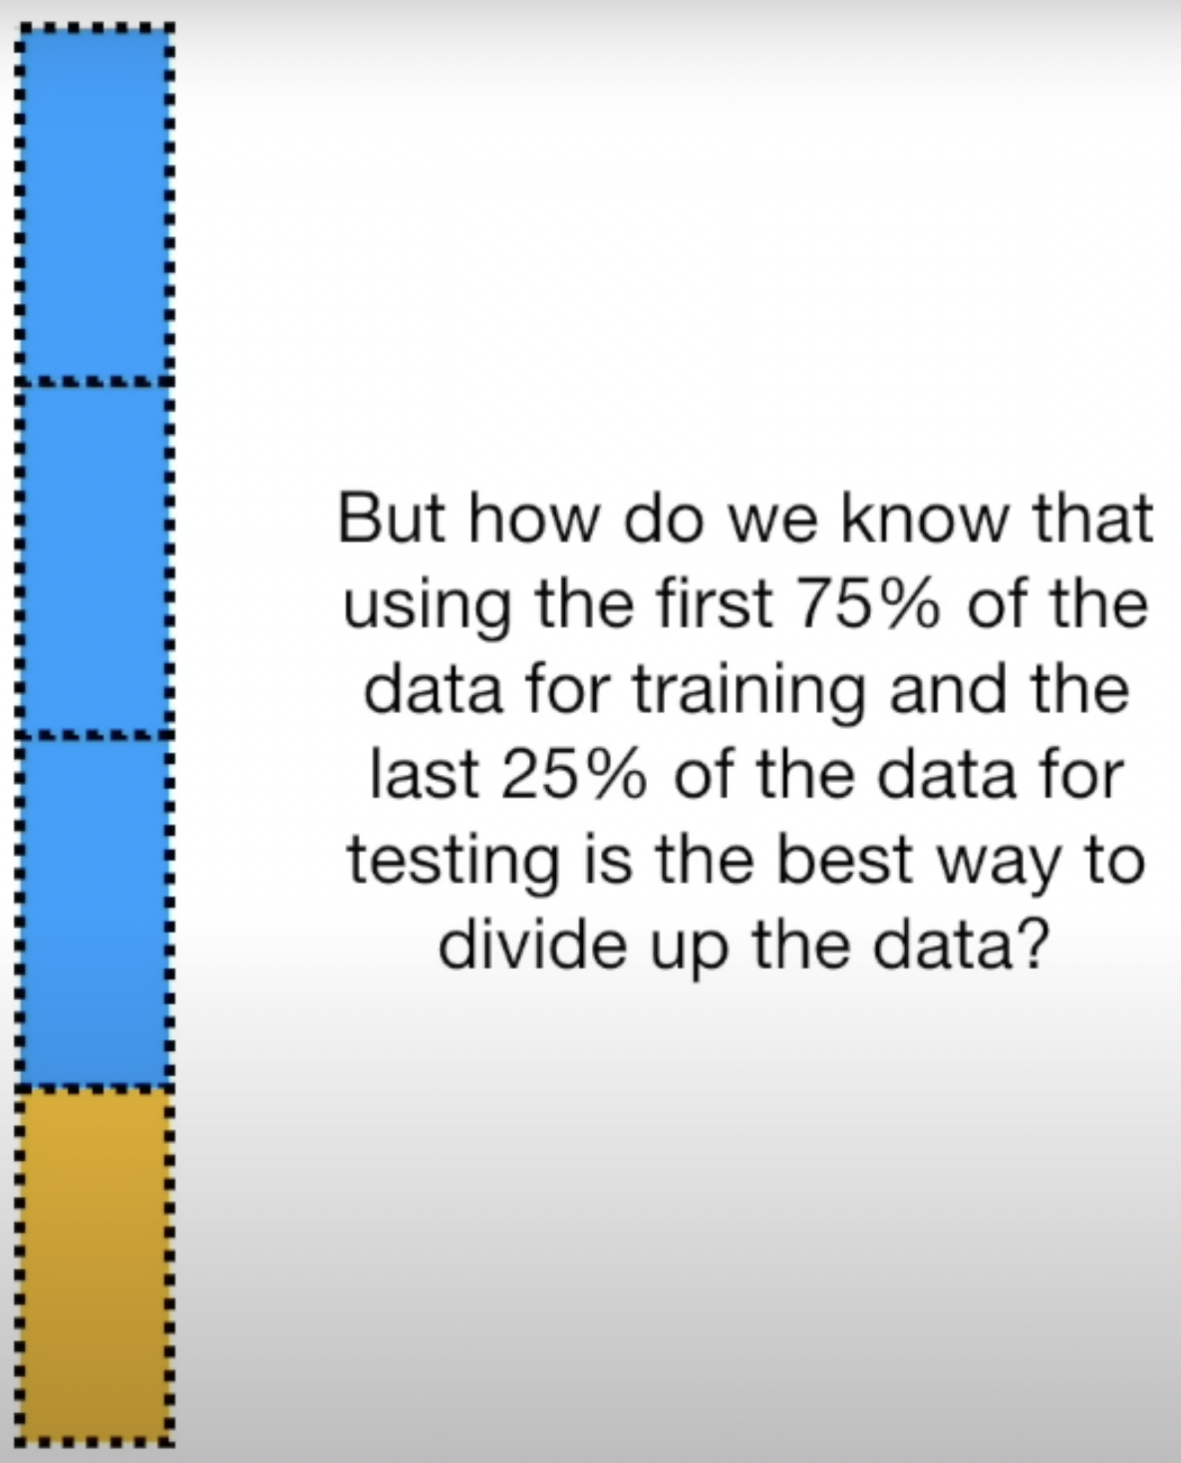
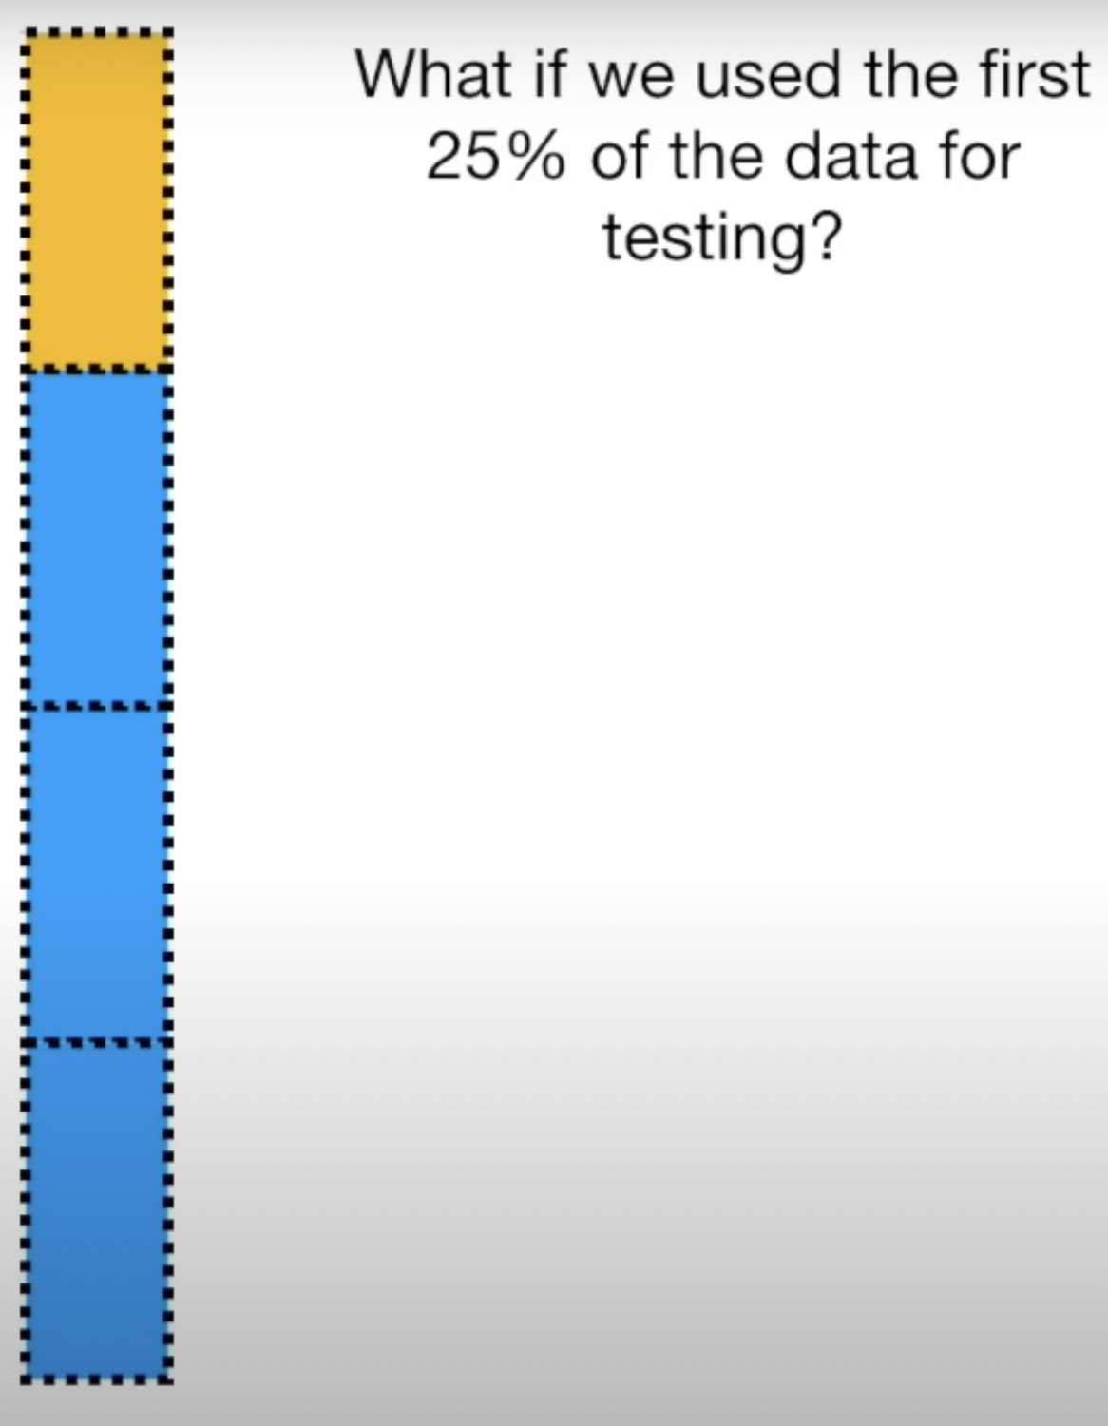

Slide 8
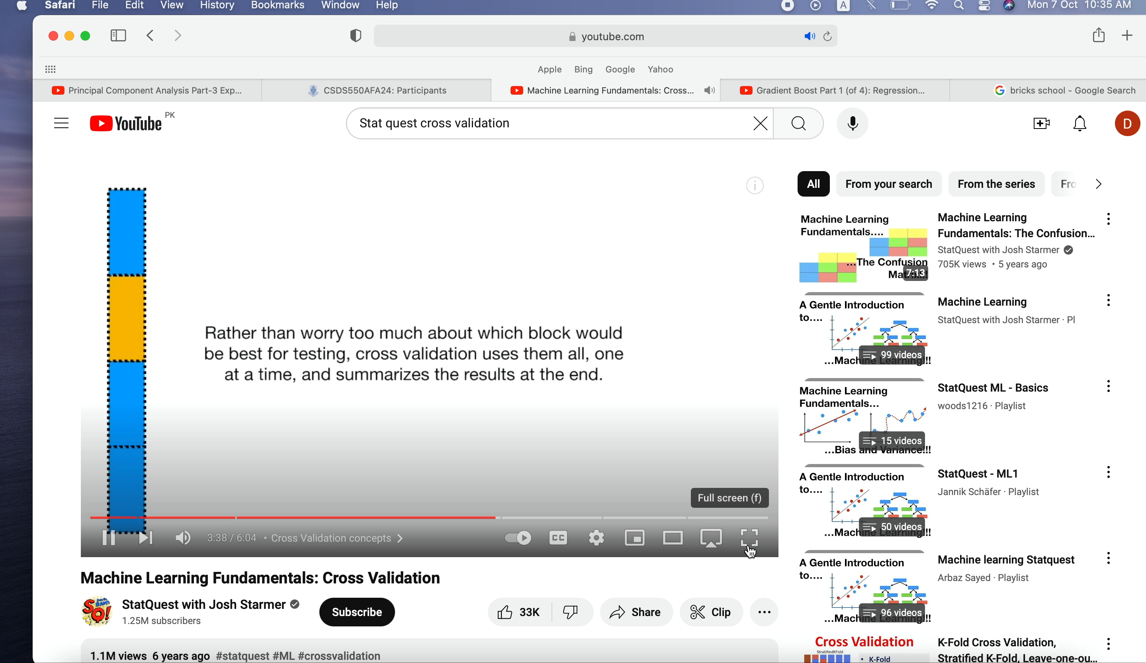

Slide 9
